Slide 1

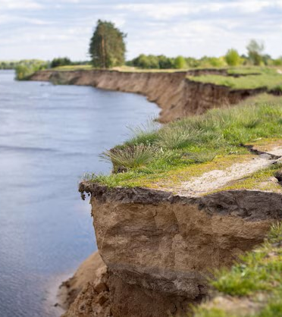
River Erosion in Bangladesh

Slide 2
Ms. Saida Mahamuda Rahman
Lecturer
Dept. of CSE
Daffodil International University

Slide 3
Group Members
J. M. Ifthakharul Islam Shajan (232-15-813)
Md. Al Sahariar Noyn (232-15-814)
Pritom Saha Turjo (232-15-742)
Abdullah Al Noman (232-15-797)
Jannatul Maoya Meem (232-15-436)

Slide 4
Table of contents
01
02
03
04
05
06
What is River Erosion
Processes River Erosion
Causes of River Erosion
The effect of River Erosion
Impact of River Erosion
Prevention of River Erosion

Slide 5
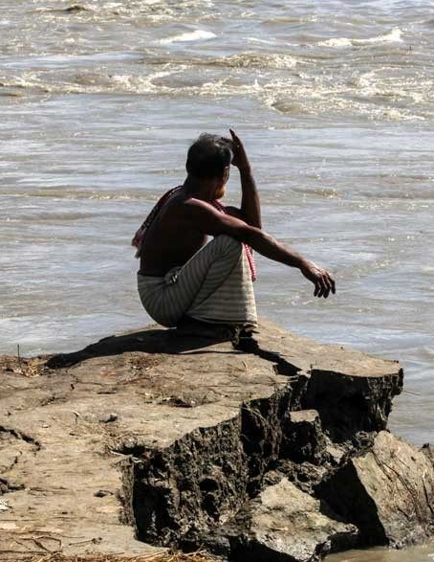
What is River Erosion?
04
River erosion is the wearing away of the banks of a stream or river. This is distinguished from erosion of the bed of the water course.
River Erosion an endemic and recurrent natural hazard. When rivers enter the mature stage, they become sluggish and meander or braid. These oscillations cause massive riverbank erosion.

Slide 6
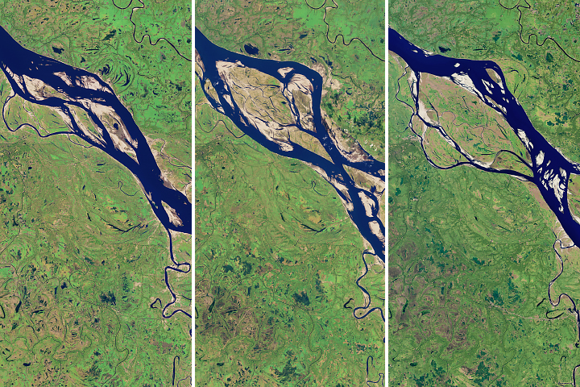
Processes of River Erosion
05
Hydraulic Action:
 Decomposition of rock particles from river bed due to water pressure
 Occurs near water falls and fierce forced streams of rivers
Abrasion:
 Wearing away of river banks by river sediments.
 Occurs during the depression stage of rivers.

Slide 7
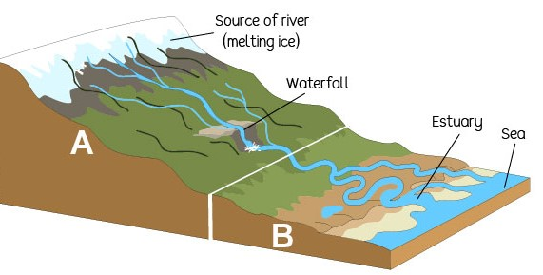
Processes of River Erosion
06
Corrosion:
 Carbon dioxide dissolves in the river to form a weak acid.
 It forms limestones and chalks are found as sediments.
Attrition:
 Eroded particles collide and break into smaller particles
 The edges of rock particles becomes more rounded and smaller.

Slide 8
Causes of River Erosion in Bangladesh
07
Mature stage of River
Sedimentation in the River beds
Geological Shape
The flat delta lands of Bangladesh offer little resistance to the hydraulic forces of its rivers, particularly during periods of high flow.
When rivers enter the mature stage, they become sluggish and meander or braid. These oscillations cause massive riverbank erosion.
Vast quantities of water, these rivers carry about 1.1 billion tons of sediment every year and are responsible for the prevalence of flooding and riverbank erosion in Bangladesh.

Slide 9
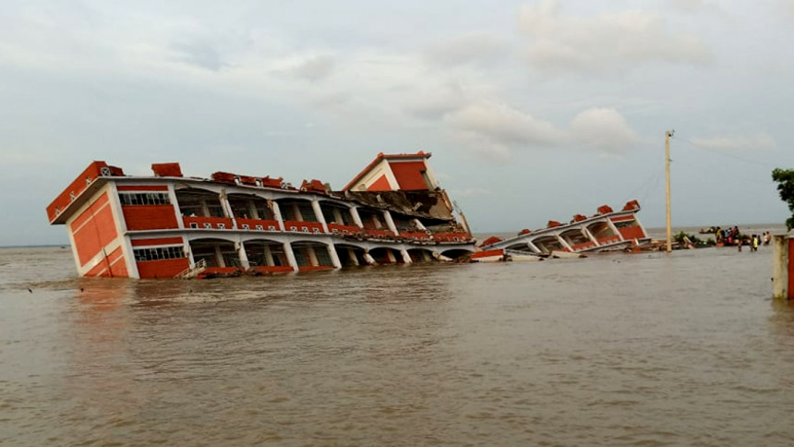
The effects of River Erosion
08
Displacement of people from one place to another.
Affect in public health.
Educational structure is also negatively changed.
Affect in the occupation of the affected people.
Unemployment Problems can be increased.
Poverty in society.
Affect in the transport system.
Agricultural demotion.
Shortage of cropland.
Losses crops.
Increase landless labor.

Slide 10
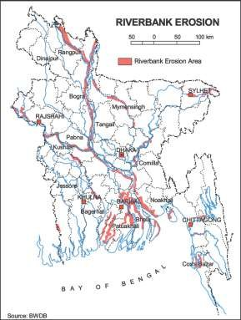
09
Bangladesh’s Erosion Affected Area
The map shows Bangladesh's main erosion-prone areas along major rivers:
Jamuna River: Affects Rangpur, Kurigram, Tangail.
Padma River: Impacts areas around Dhaka.
Meghna River: Erosion in Chandpur, Noakhali.
Southern Coastal Areas: Barisal, Patuakhali face severe erosion.
These areas experience significant land loss and displacement of communities.

Slide 11
The major rivers responsible for River Erosion
10
Vulnerable Rivers:
According to Banglapedia, The following rivers
are vulnerable for bank erosion.
The Padma
The Upper Meghna
The Lower Meghna
The Jamuna
The Brahmaputra

Slide 12
Factor that Accelerate River Erosion
11
Stream bed lowering or in fill.
Flooding of bank soils followed by rapid drops in flow.
Saturation of banks from off-stream source.
Redirection and acceleration of flow within the channel.
Poor Soil Drainage.
Wave Action.
Excessive Sand/Gravel Extraction.
Intense Water from Rainfall.

Slide 13
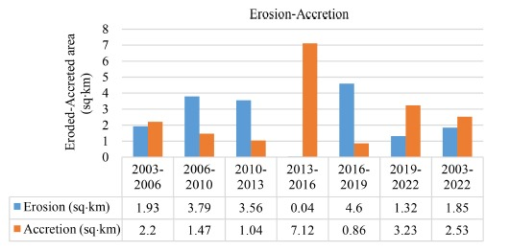
River Bank Erosion Losses in Bangladesh
12
It is estimated that about 5% of the total FLOODPLAIN of Bangladesh is directly affected by erosion.
Bank erosion is taking place in about 94 out of 489 upazilas of the country.
At present, bank erosion and FLOOD hazards in nearly 100 upazilas have become almost a regular feature. Of these, 35 are severely affected.
Building sloping down due to river bank erosion.

Slide 14
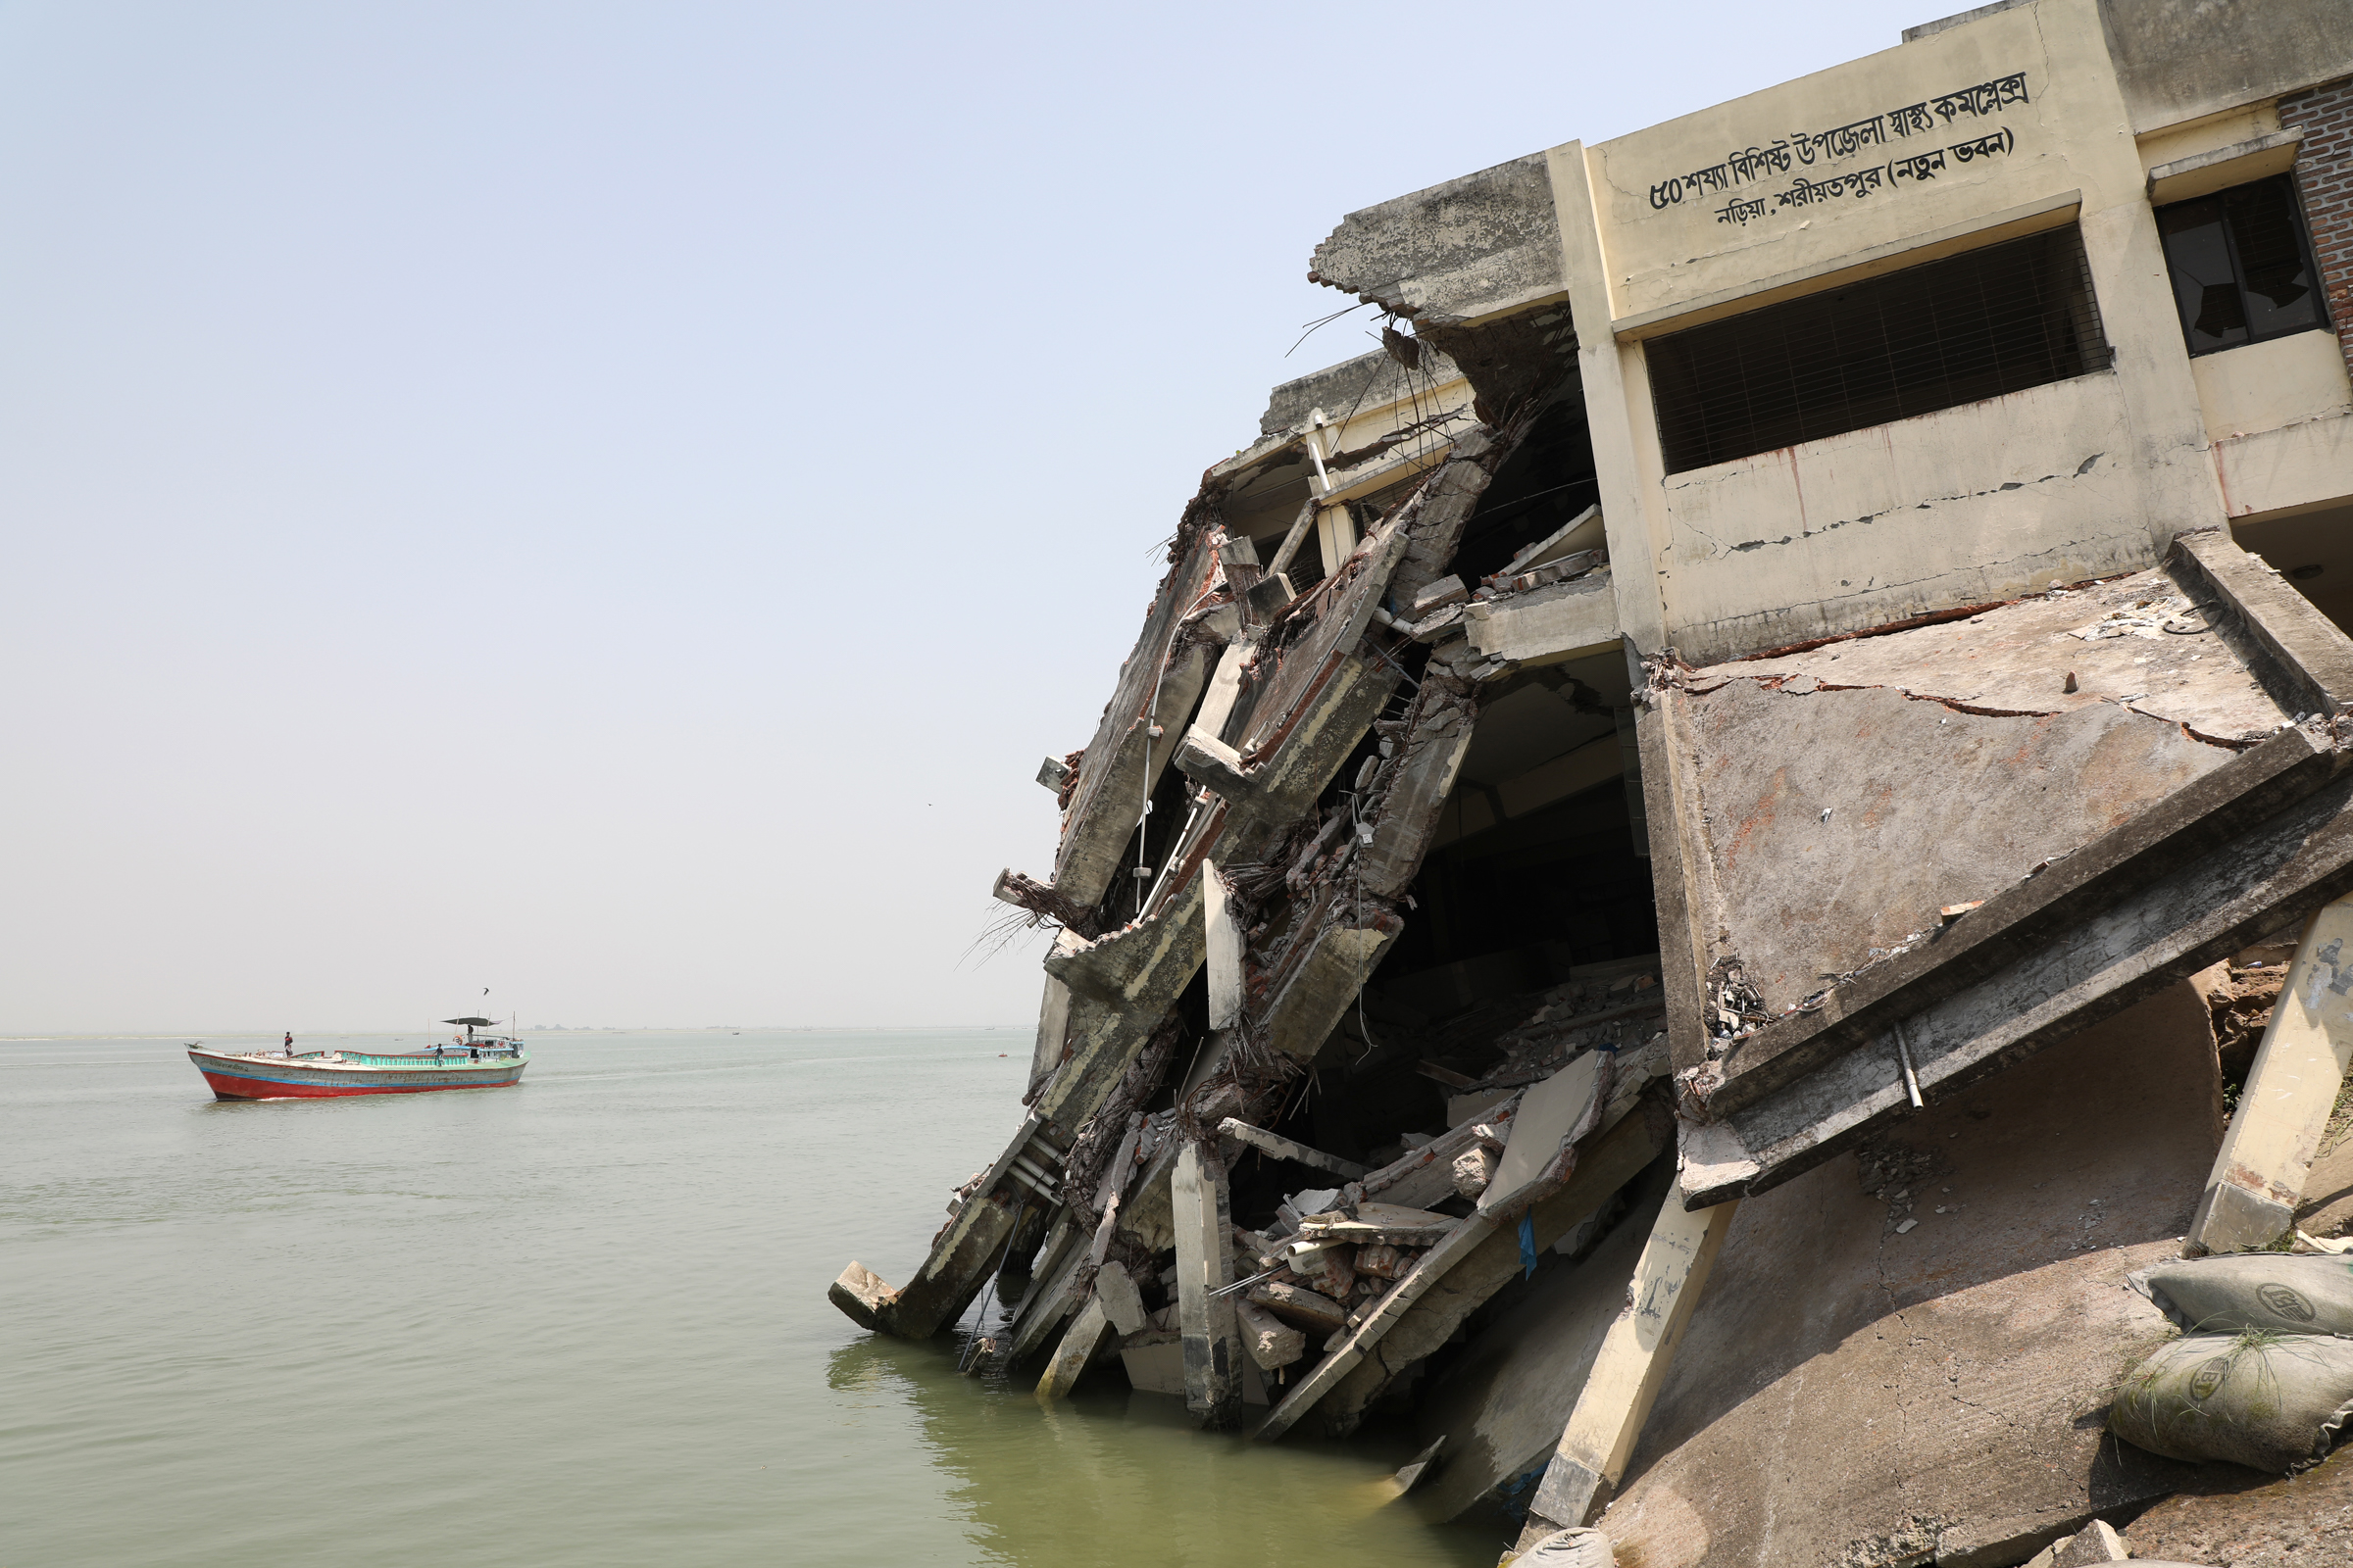
Impacts of River Bank Erosion
13
Social Impact:
Homelessness,
Migration,
Identity Crisis
Economic Impact:
Loss of Productive Land,
Loss of Employment,
Risk of Poverty
Other Impact:
Health Damage,
Criminal Activities,
Building Collapse.

Slide 15
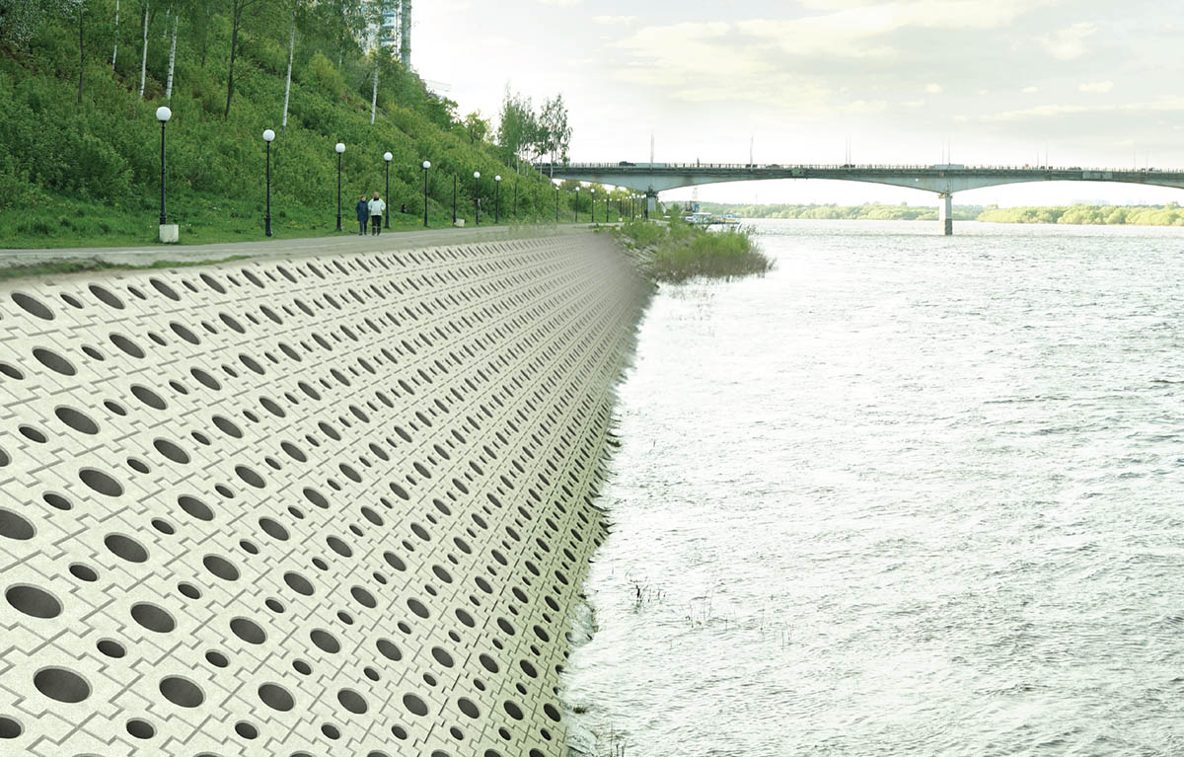
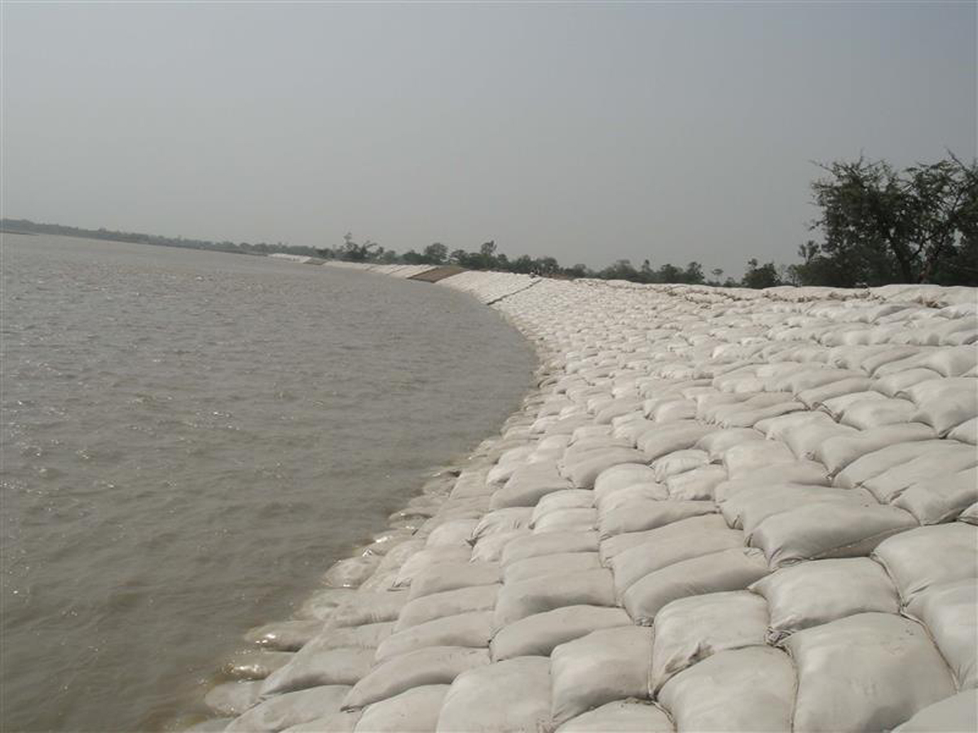
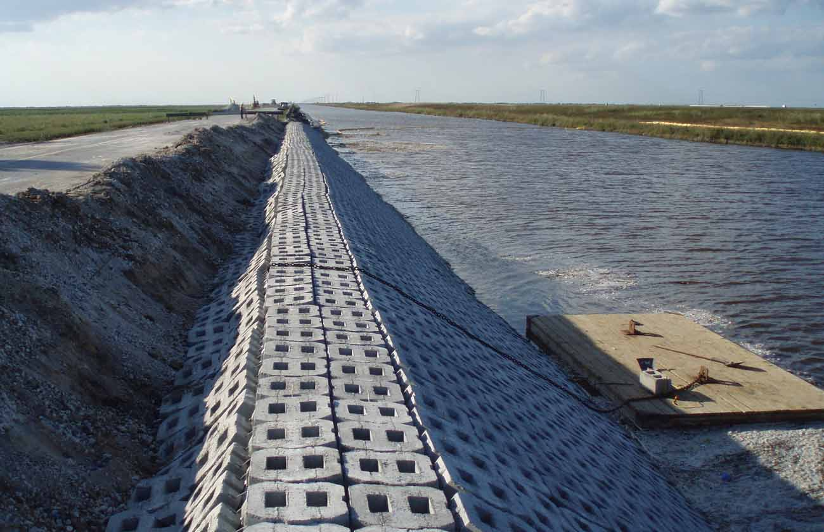
Prevention of River Erosion
14
To prevent such damage, concrete rubble, grouted riprap, concrete stone masonry, reinforced concrete or concrete block revetments should be used. Concrete supports should be used for concrete revetments. These structures should be provided with concrete backfill for greater stability.

Slide 16
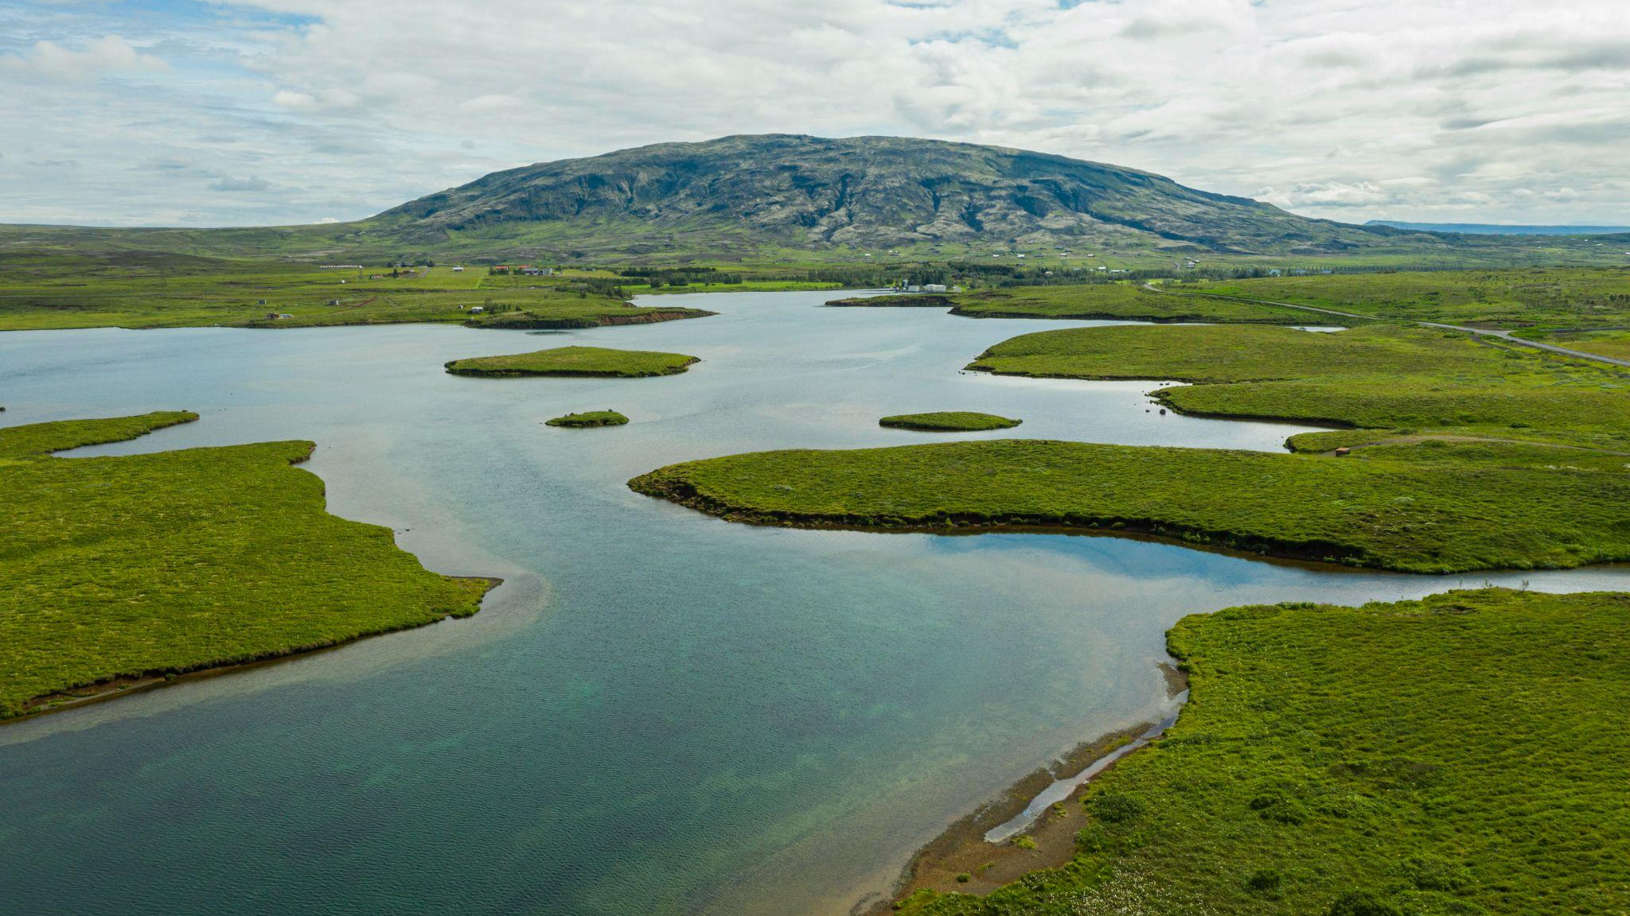


An impactful photo to inspire change

Slide 17



Slide 18

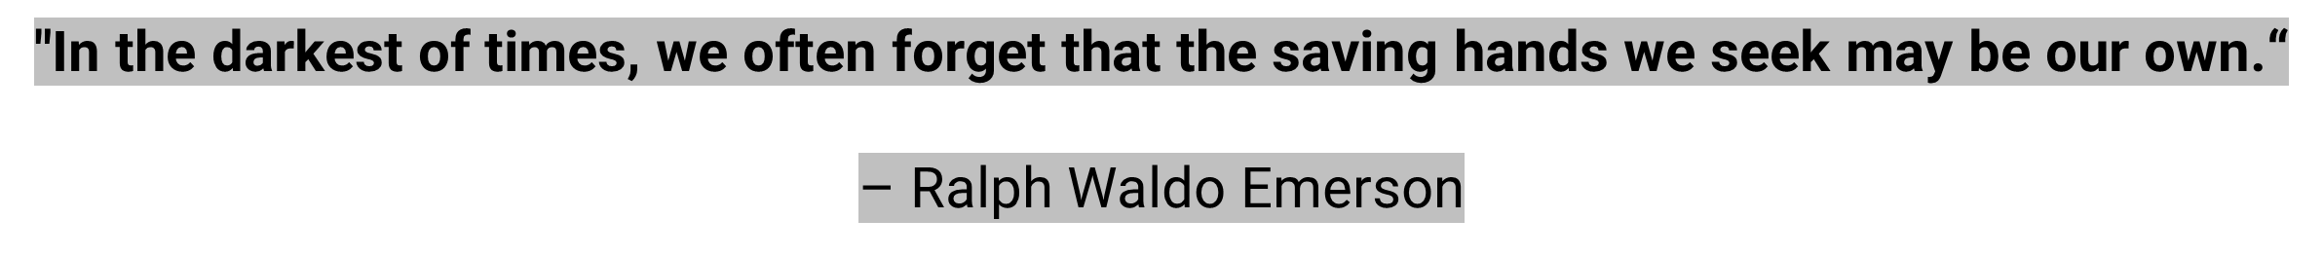
Thank You!

